Slide 1
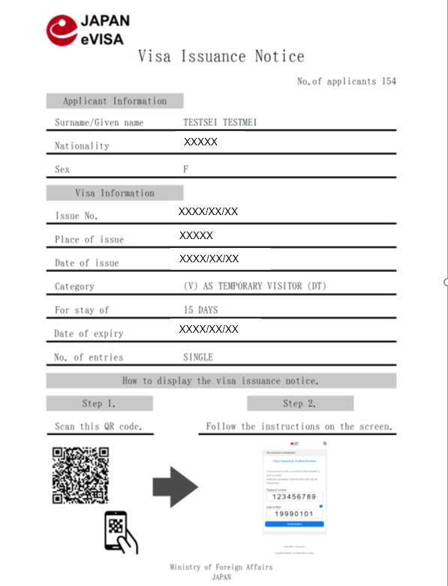
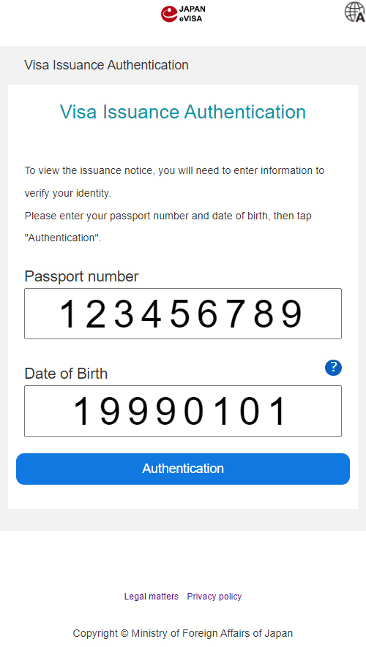
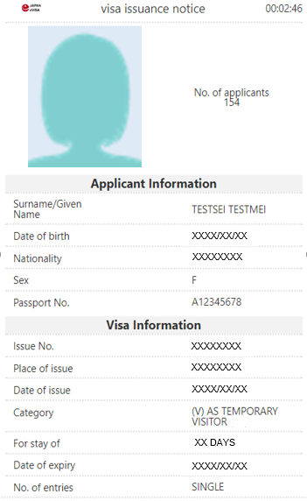
When checking-in at the airport, you will be requested to display a “visa issuance notice” on your device. Travel agency will provide you a "Visa Issuance Notice" (printed or pdf data) with two dimensional barcode.
Please scan the two dimensional barcode with your device and enter the required information to display the notice.
By tapping “Display“, the electronic "visa issuance notice" appears and the countdown timer shown at the top right starts immediately. This countdown proves that the notice is valid.
How to display “visa issuance notice”
→
Specimen
Specimen
→
Specimen
→
→
Display
Scan the two dimensional barcode printed
on the “Visa Issuance Notice” (pdf).
Please note that the two dimensional barcode will be given individually.
2. Please enter required information
then tap “Display”.
3. “visa issuance notice” will be displayed on your device.
Make sure the timer counts down
at the top right.

